Slide 1
Nuclear Fusion
By Ryan BIbby and Gadiel Muniz

Slide 2
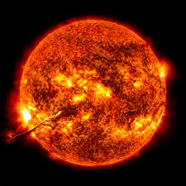
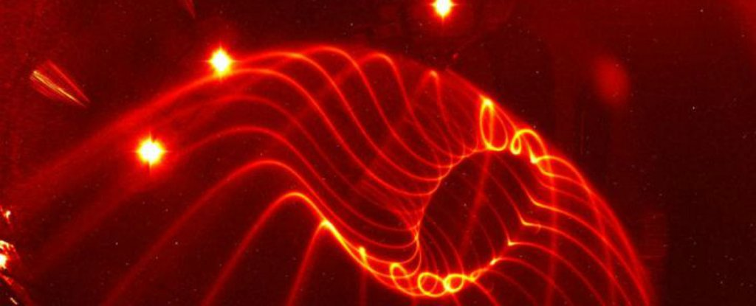
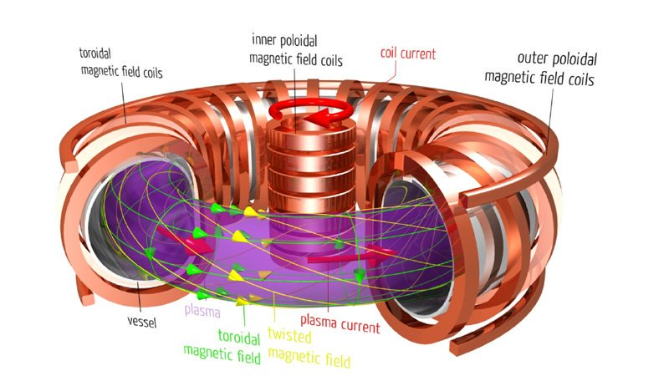
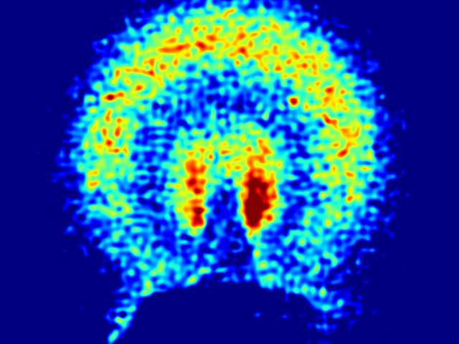
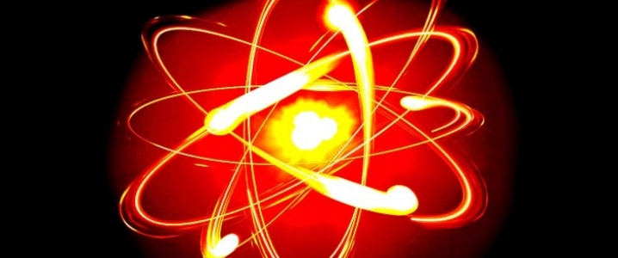
The advantages
It is a safer way to get power and damages the environment than other power sources.
The power can last a lot longer than most power sources.
If we did have nuclear fusion and something were to go wrong it would not blow up like a nuclear power plant.
If there ever was a leak it would just be helium so no danger to the atmosphere or surrounding area

Slide 3
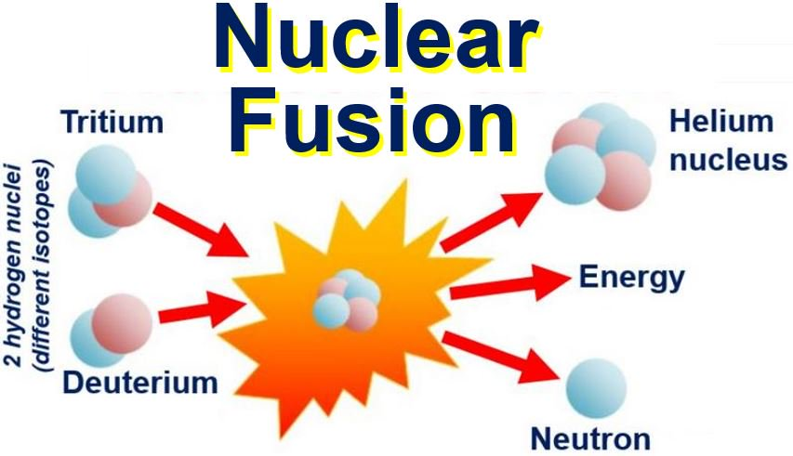
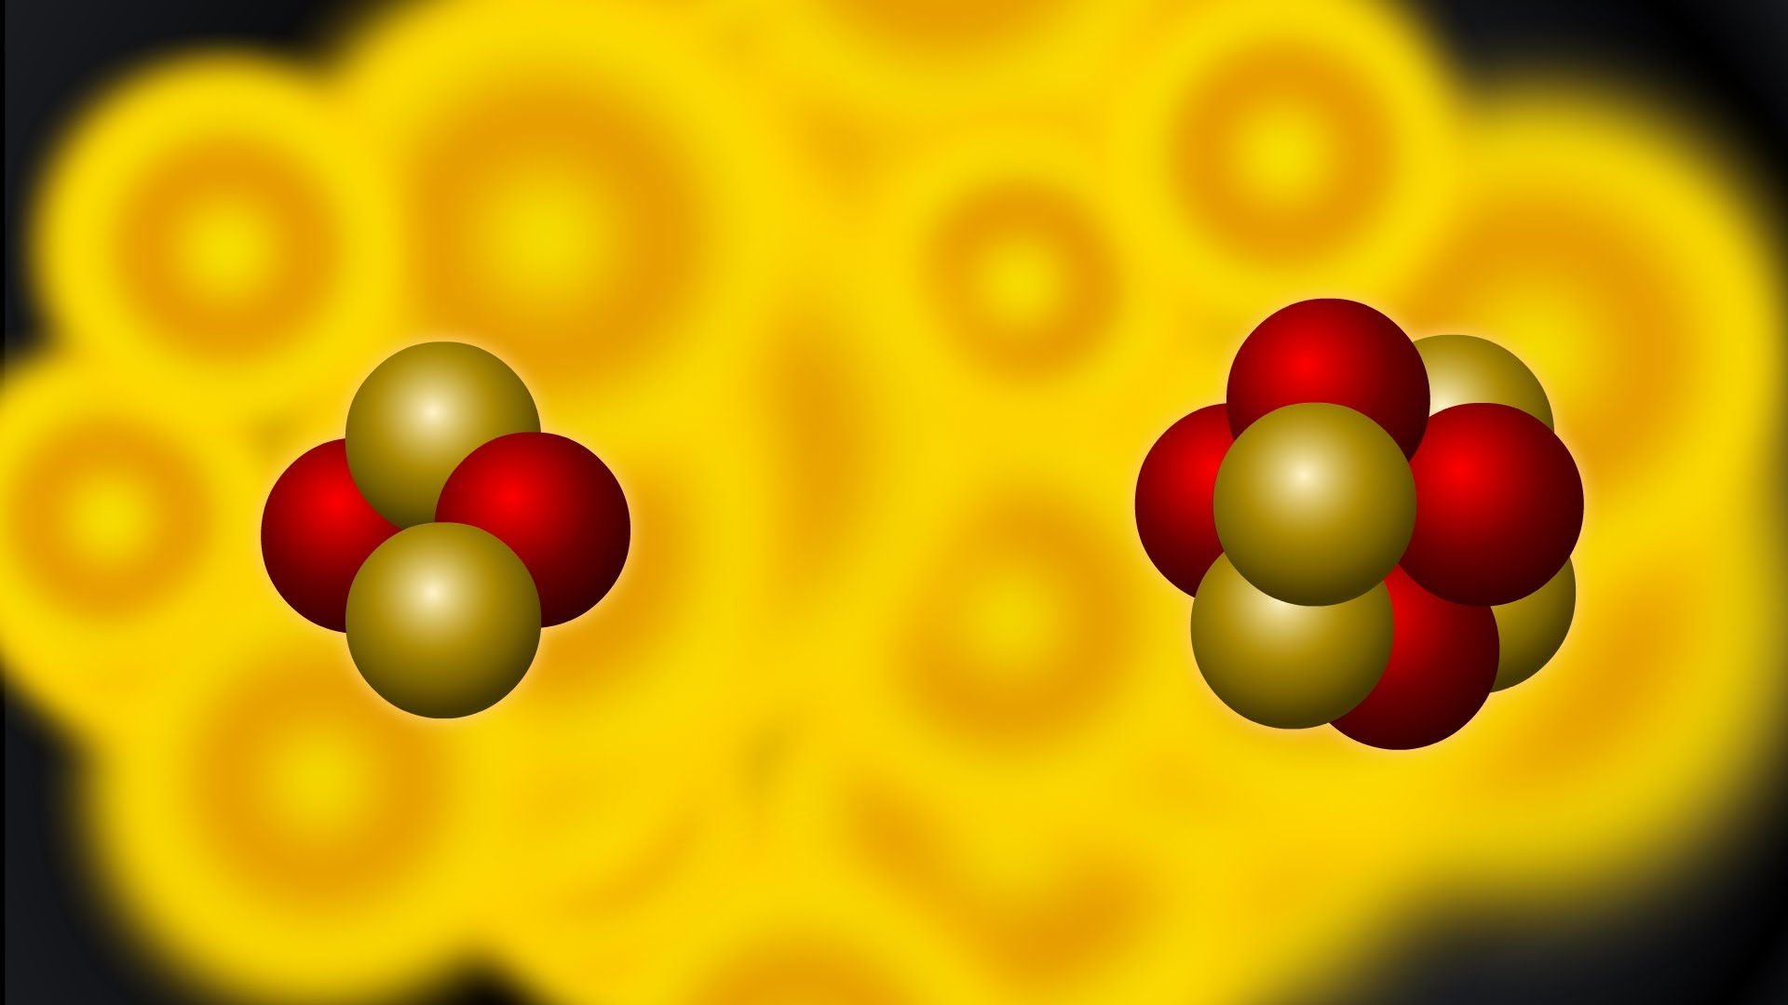
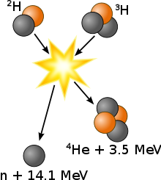
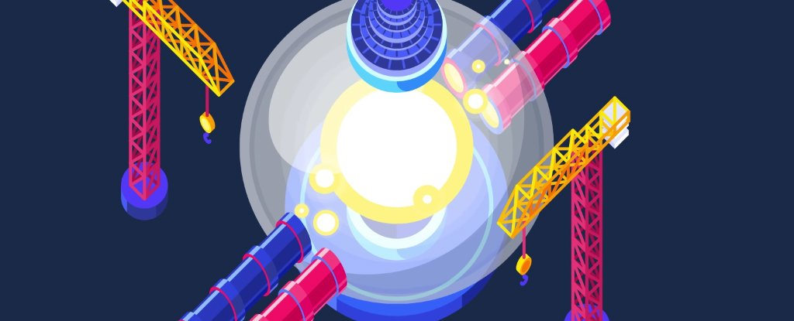
How it works
Nuclear fusion is a thermonuclear process, this means the temperature for the reaction take place is so hot that the electrons are stripped of the nucleus.
They have to be moving very fast to fuse the nuclei together, to get them moving that fast it has to be 14,000,000 decrees celcius.
There are two types of fusion reactors today; magnetic confinement and inertial confinement(lasers).
Once we achieve stable, constant nuclear fusion one glass of sea water could power as much as one 50 pound barrel of Uranium with no waste at all.

Slide 4
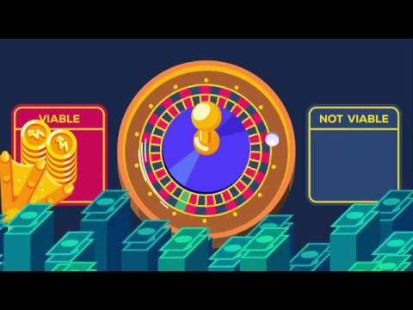
A video explaining it

